Slide 1
Direct and indirect questions

Slide 2

Direct questions
Direct questions are the “normal” questions that we can ask friends, family members, and people who we know well.
Example of a direct question:
“Where is the bathroom?”

Slide 3
Indirect questions
Indirect questions are a little more formal and polite. We use them when talking to a person we don’t know very well, or in professional situations, and their form is a little different.
Example of an indirect question:
“Could you tell me where the bathroom is?”

Slide 4
PHRASES FOR INDIRECT QUESTIONS
Could you tell me…
Do you know…
I was wondering…
Do you have any idea…
I’d like to know…
Would it be possible…
Is there any chance…

Slide 5

Examples
Direct: Where is Balmaceda Street?
Indirect: Could you tell me where Balmaceda Street is?
In indirect questions with is/are, the verb (is) comes after the subject (Balmaceda Street).

Slide 6
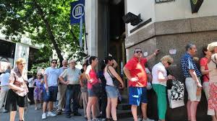
Examples
Direct What time does the bank open?
Indirect: Do you know what time the bank opens?
In indirect questions, we don’t use the auxiliary verbs do/does/did.

Slide 7
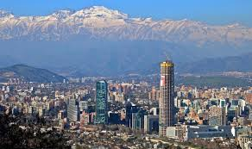
Examples
Direct: Why did you move to Chile?
Indirect: I was wondering why you moved to Europe.
Again, there is no auxiliary verb did in the indirect question.

Slide 8
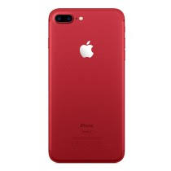
Examples
Direct: How much does the iphone 7 cost?
Indirect: I’d like to know how much the iphone 7costs.
To form the indirect question, remove does and change “cost” to “costs.”

Slide 9

Examples
Direct: Can you finish the project by tomorrow?
Indirect: Would it be possible for you to finish the project by tomorrow?
For direct questions with can, we can use the phrase “would it be possible…” to make it indirect.

Slide 10
Examples
If the direct question is a “yes or no” question, then the indirect question will have if.
Direct: Does Tom like Italian food?
Indirect: Do you know if Tom likes Italian food?
Direct: Are your parents joining us for dinner?
Indirect: Could you tell me if your parents are joining us for dinner?

Slide 11
Rewrite the sentences without changing the meaning
Where is the nearest bank?
Why is that little baby crying?
Is there any water here?
Is he coming tomorrow?
How many cars does she have?
Do they like swimming?
What does she want?

Slide 12
Answers
Could you tell me where the nearest bank is?
Do you know why that little baby is crying?
Do you know if there is any water here?
Could you tell me if he is coming tomorrow?
Do you know how many cars she has?
Do you know if they like swimming?
Could you tell me what she wants?

